Slide 1
Development of Computer Vision and Image Processing at NSLS-II
William Watson

Slide 2
Purpose
Development of image analysis software backed by OpenCV
To provide an easy use python module to access computer vision functions
Optimized results for fast computation, via C++, Intel IPP/TBB
Automate processes from image input such as:
Positon, spread, and intensity of X-Ray Beams
Isolating and computing data on multiple objects
Provide assistance to mounting samples and report any errors

Slide 3
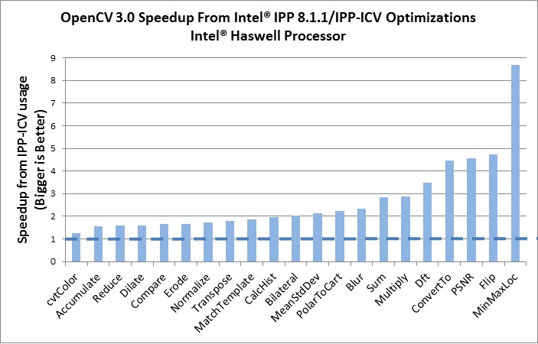
OpenCV and CVLIB
Small Program
CVLIB
OpenCV (Python Wrapper to C++)
Intel IPP/TBB Functions on IBM Server
Optimized Results
Small Programs call upon functions in CVLIB
CVLIB calls upon OpenCV, which has a Python Wrapper for C++
OpenCV 3.0 supports optimization via Intel’s IPP Low Level Functions, Intel TBB
Computation is done on a dedicated IBM Image Server
Sergey Sivolgin, 2014-08-11 11:25 am

Slide 4
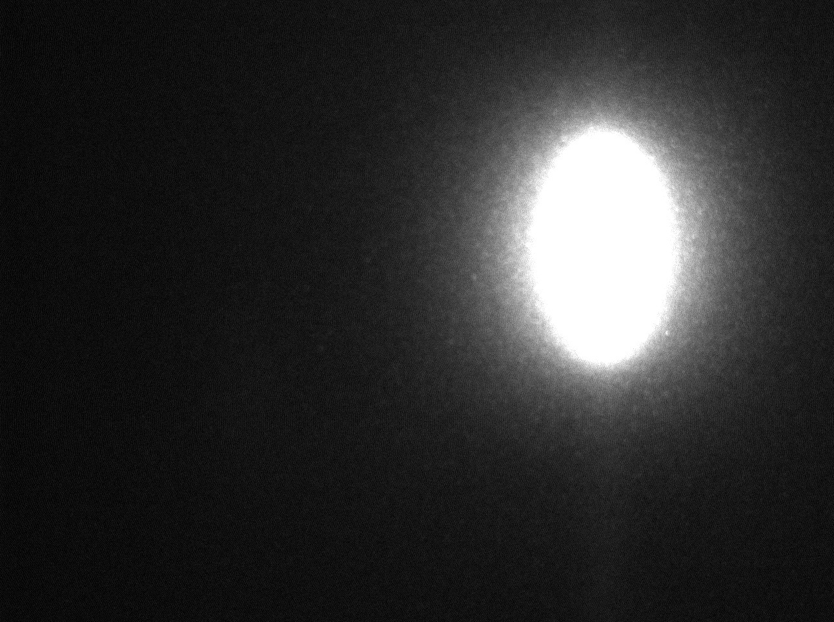
BPM-1 X-Ray Analysis (IXS)
Purpose:
Discover Position of Beam
Discover Spread of Beam
Discover Intensity of Beam
Discover the Centroid of the Beam
E = 9.1 keV
Scintillator: YAG
Camera: Prosilica
Magnification: 5x
Images Courtesy of: Yong Cai, Alessandro Cunsolo, Alexey Suvorov, and the IXS Beamline Staff

Slide 5
BPM-1 X-Ray
Located in B Hutch (IXS)
1st XBPM
2nd XBPM
3rd XBPM
Images Courtesy of: Yong Cai, Alessandro Cunsolo, Alexey Suvorov, and the IXS Beamline Staff

Slide 6
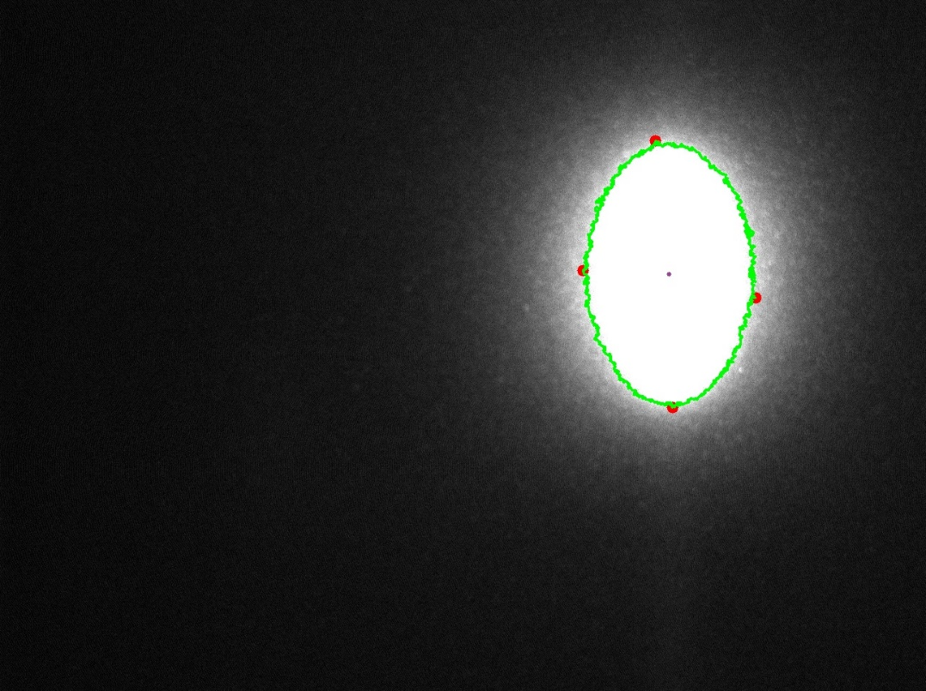
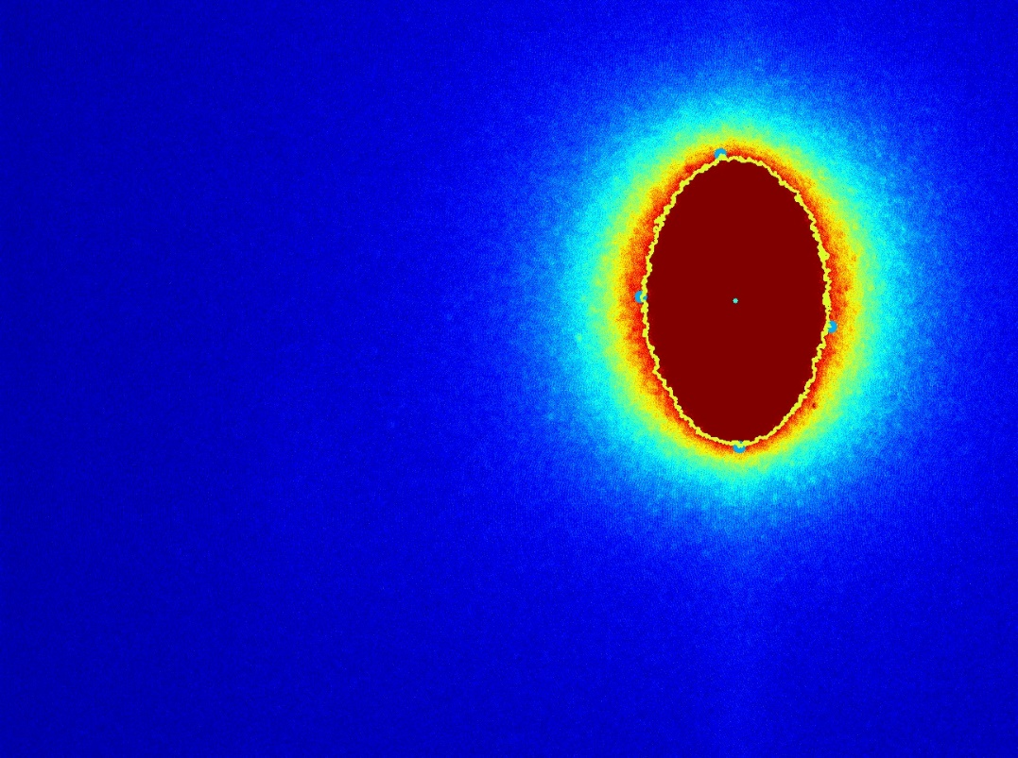
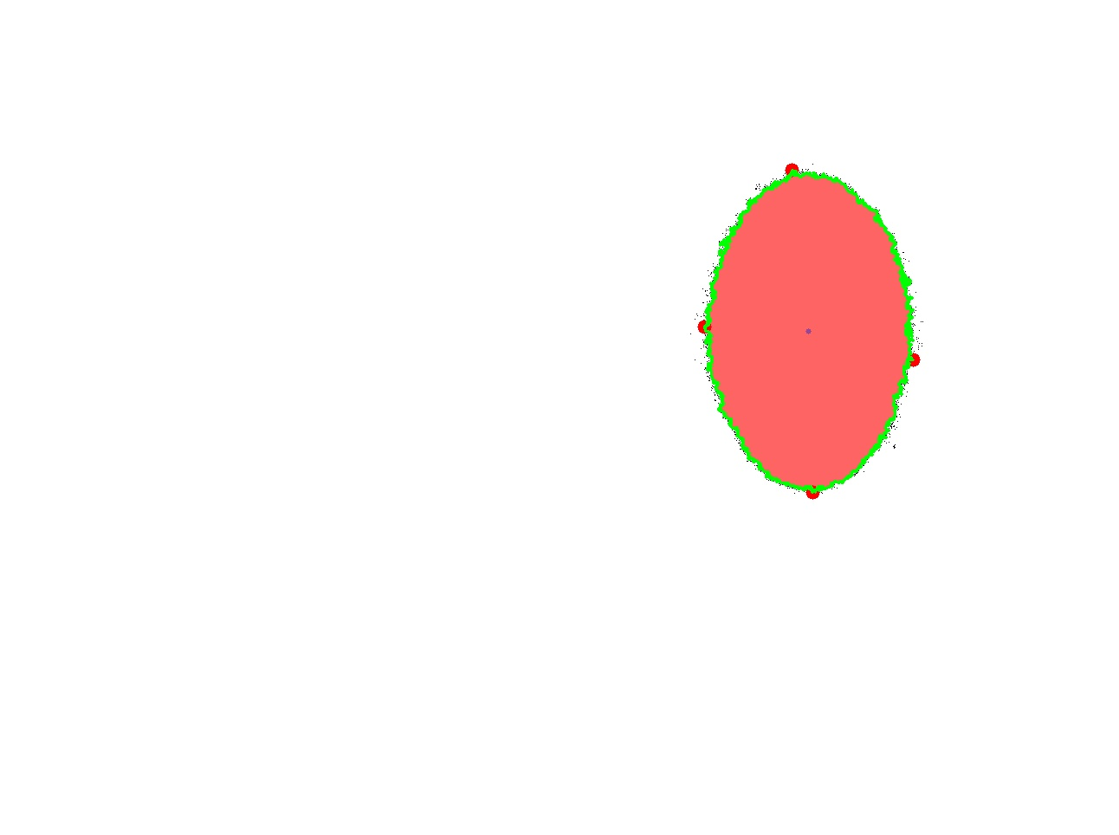
BPM-1 Image Results
Process:
Threshold
Find Contours
Interpret Contour Data (Plot, Draw, and Print)
Result Superimposed on Original
Thresholding Result
Jet Color Map
Images Courtesy of: Yong Cai, Alessandro Cunsolo, Alexey Suvorov, and the IXS Beamline Staff

Slide 7

BPM-1 Data Results
Console Output:
Object Details:
perimeter: 2356.99022925
orientation: 179.838363647
max: (925, 198)
height: 372
extrema: {'B': (938, 568), 'R': (1054, 415), 'L': (813, 377), 'T': (914, 196)}
area: 65058.5
min: (1047, 564)
sum intensity: 20426526
width: 241
centroid: (933, 382)
mean intensity: 227.842390577
Images Courtesy of: Yong Cai, Alessandro Cunsolo, Alexey Suvorov, and the IXS Beamline Staff

Slide 8
BPM-1 Results
Use Centroid and Extrema to adjust beam within image
Sum of the Pixels displays the total intensity of the beam
The Maximum point of intensity, and maximum intensity discovered
Area and Perimeter of Beam
Height and Width of the current Beam
Average Intensity of the Beam

Slide 9
BPM-1 Time
BPM-1 (Single):
Real 0m0.350s
User 0m0.300s
Sys 0m0.068s
Images Courtesy of: Yong Cai, Alessandro Cunsolo, Alexey Suvorov, and the IXS Beamline Staff

Slide 10
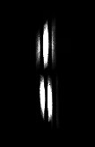
Analysis -Merlin Quad X-Ray Detector (IXS)
Data Retrieved from the Merlin Detector at IXS
Purpose:
Isolate Individual Streaks
Process each Streak to learn Position, Center, Spread, Intensity, Max Values, etc.
Count Intensity in each streak
E = 9.1 keV
Direct detection
PEL size = 55 [um]
Images Courtesy of: Yong Cai, Alessandro Cunsolo, Alexey Suvorov, and the IXS Beamline Staff

Slide 11
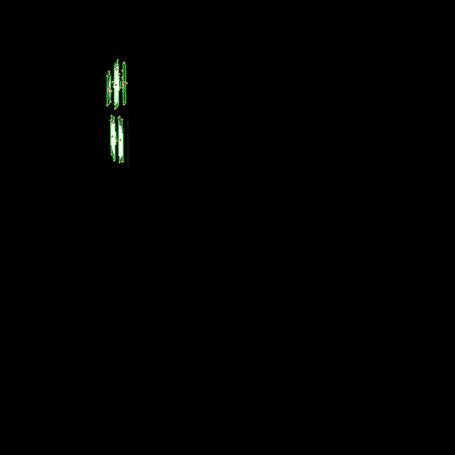
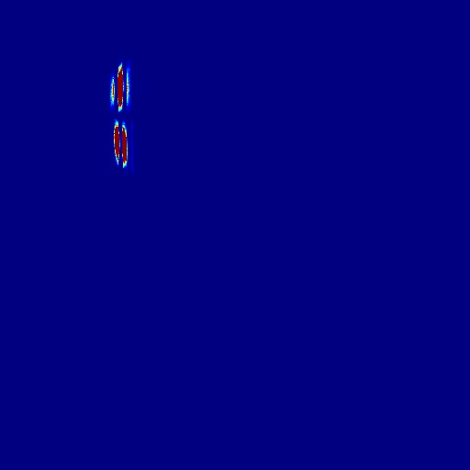
Merlin Image Results
Process:
Convert to Grayscale
Threshold Image
Find and filter contours by size
For each object:
Print Object’s Data
Plot Points of Interest
Draw Contours
Apply JET
Images Courtesy of: Yong Cai, Alessandro Cunsolo, Alexey Suvorov, and the IXS Beamline Staff

Slide 12
Merlin Data Results for First Object (Largest)
Console Output:
Object 1:
perimeter: 125.840619564
orientation: 179.981033325
max: (131, 78)
height: 55
extrema: {'B': (129, 122), 'R': (135, 98),
'L': (126, 92), 'T': (132, 67)}
area: 270.5
min: (134, 83)
sum intensity: 62689
width: 9
centroid: (130, 95)
mean intensity: 126.644444444
Images Courtesy of: Yong Cai, Alessandro Cunsolo, Alexey Suvorov, and the IXS Beamline Staff

Slide 13
Merlin - Time
Merlin (1 Image Standalone):
Real 0m0.321s
User 0m0.284s
Sys 0m0.036s
Images Courtesy of: Yong Cai, Alessandro Cunsolo, Alexey Suvorov, and the IXS Beamline Staff

Slide 14
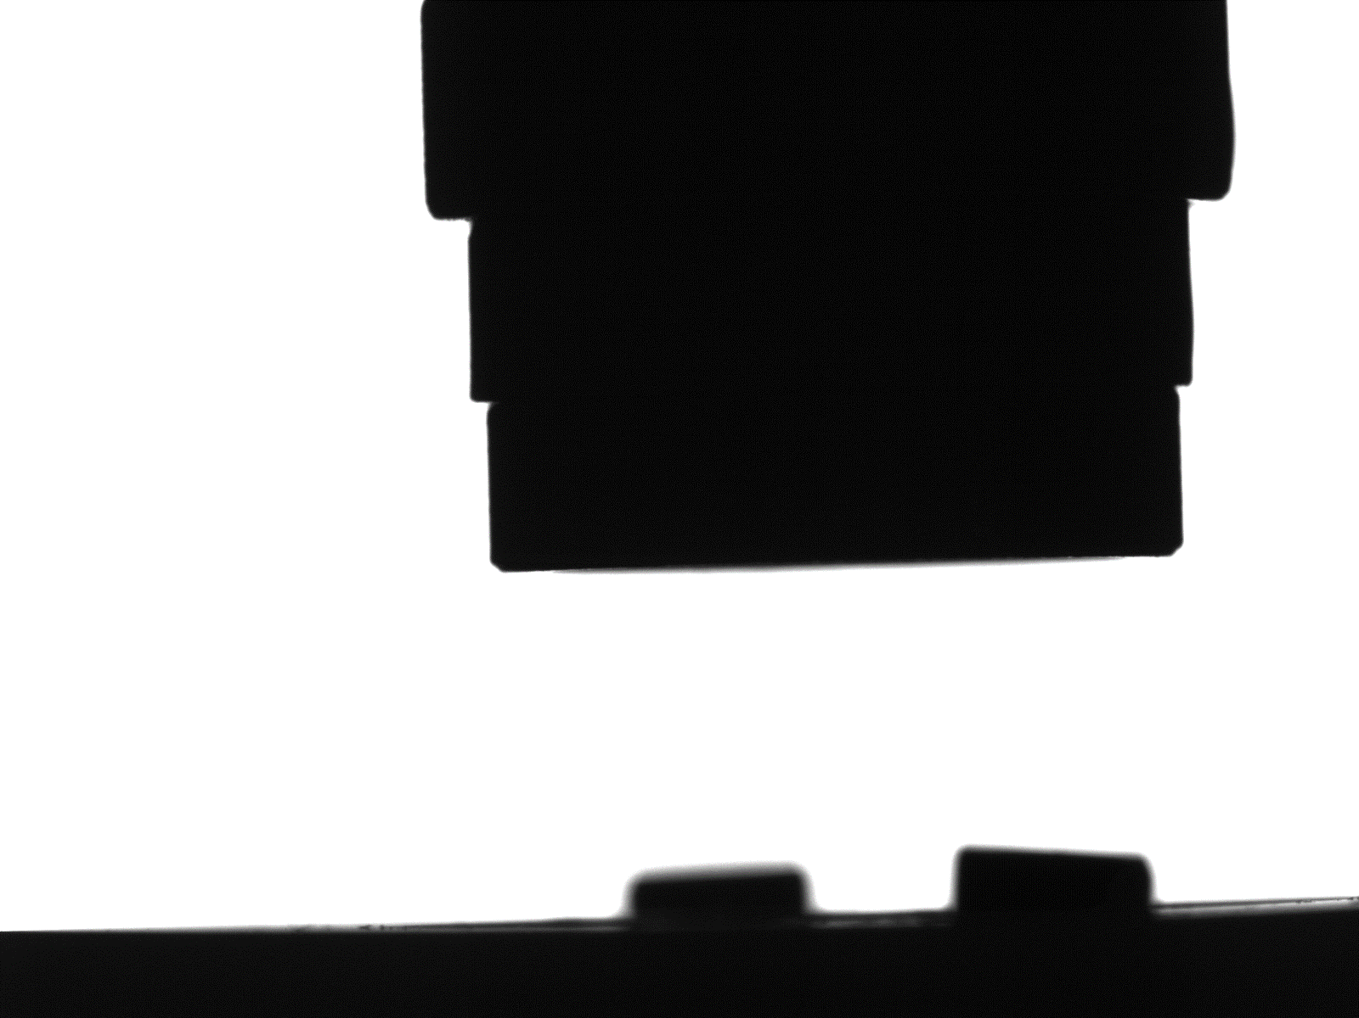


ABBIX Beamlines (AMX): Pins in a Robot Gripper
Images are from AMX, Displays a Pin and a Gripper, in an attempt to grab the pin
Pin and Gripper ‘Perfect’ Image
Pin Template Image
Gripper Template Image
Images Courtesy of: Jean Jakoncic, AMX Beamline

Slide 15
Robot Gripper - Purpose
Purpose:
Find if Pin is in the Gripper
Determine if Pin is properly mounted
Analyze the position of the Gripper and Pin within the image
Find the Region of Interest (ROI) for the Pin and Gripper
Compare the Pin and Gripper to a ‘Perfect’ Image to determine if anomalies are present
Advise the user to any potential problems
Images Courtesy of: Jean Jakoncic, AMX Beamline

Slide 16
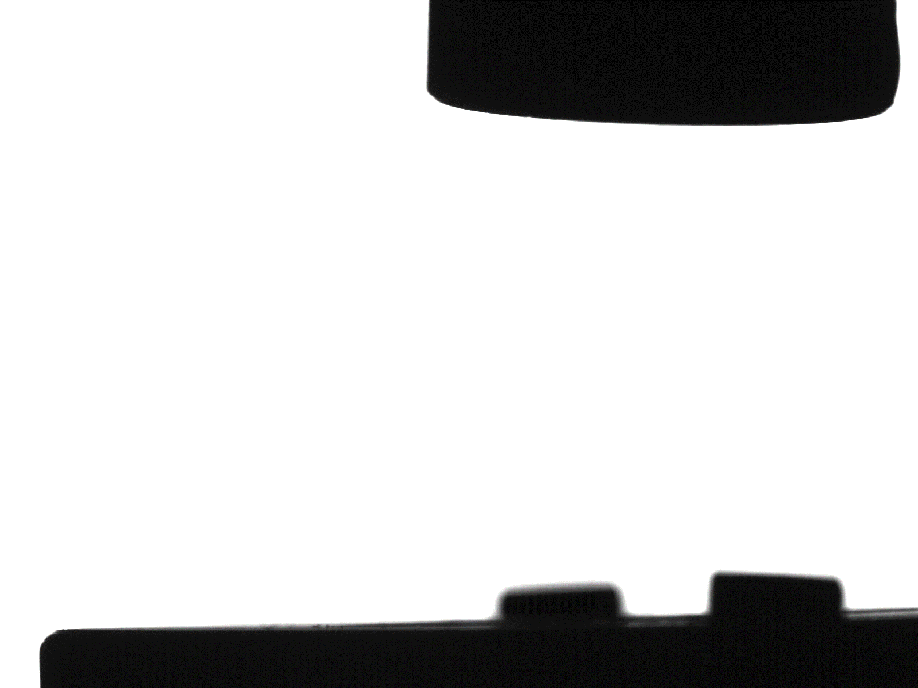
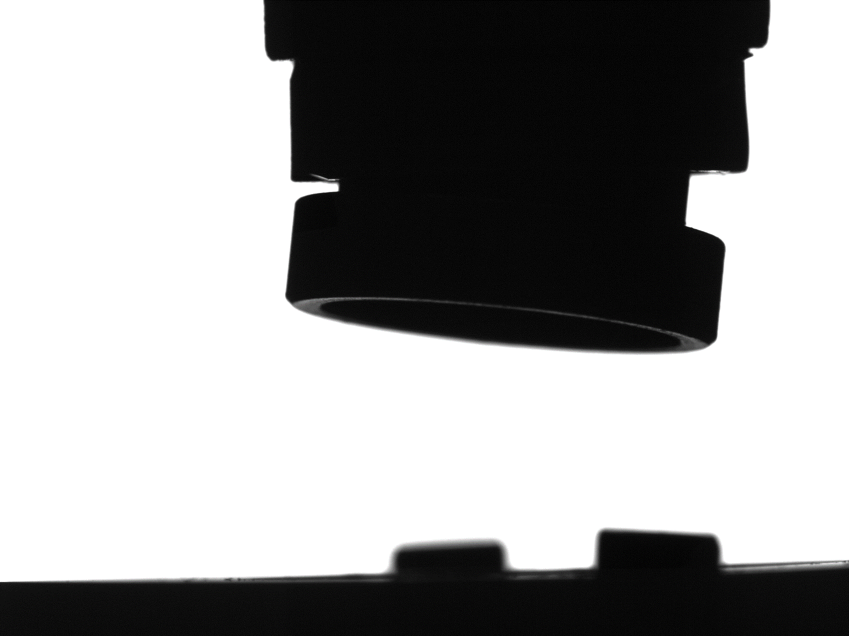

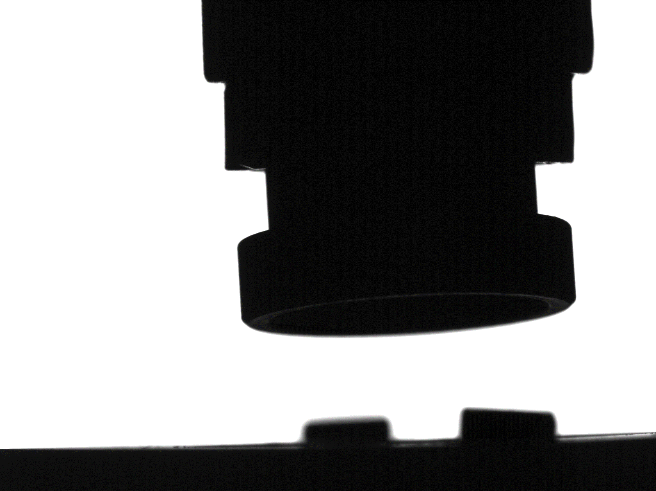
Robot Gripper– ‘Perfect’ vs Test Cases
Image 1
Image 2
‘Perfect’
Image 3
Image 4
Images Courtesy of: Jean Jakoncic, AMX Beamline

Slide 17
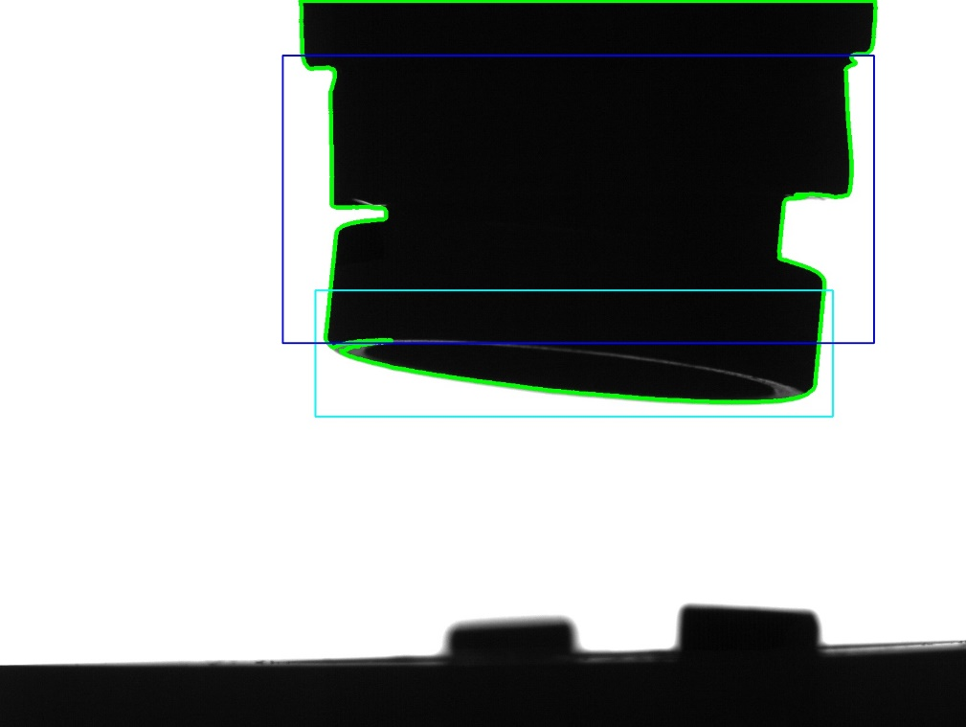
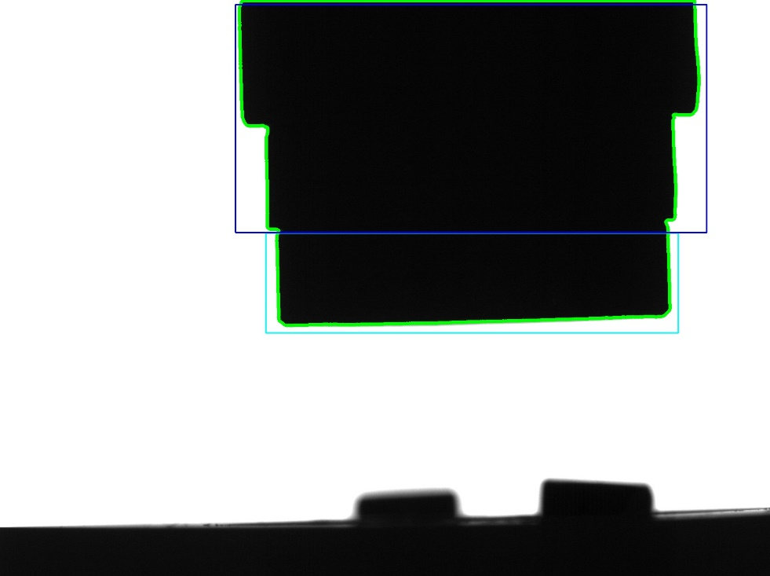
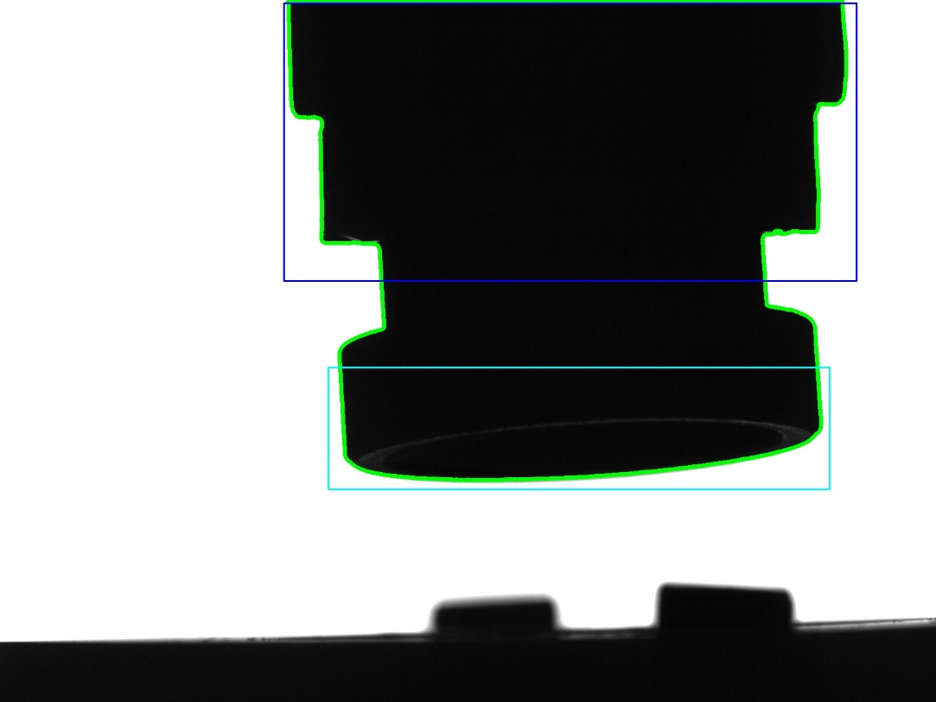
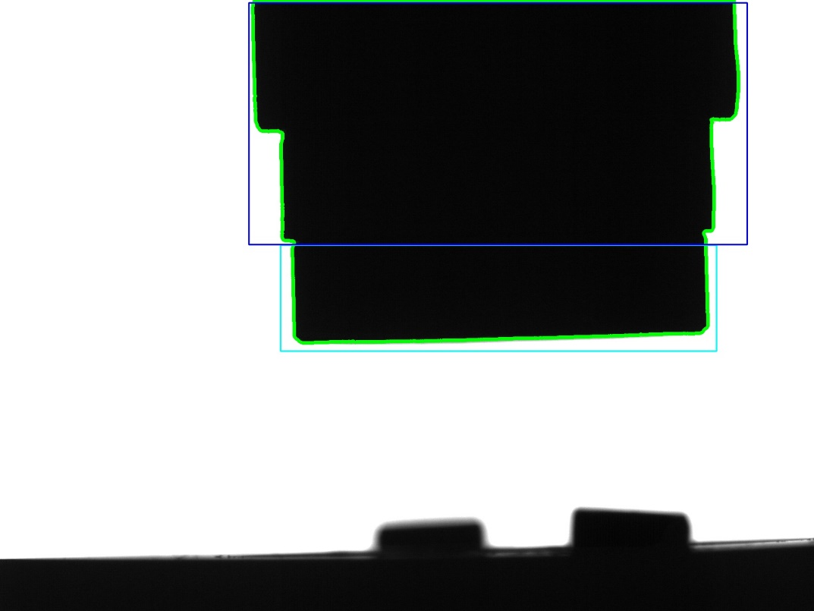
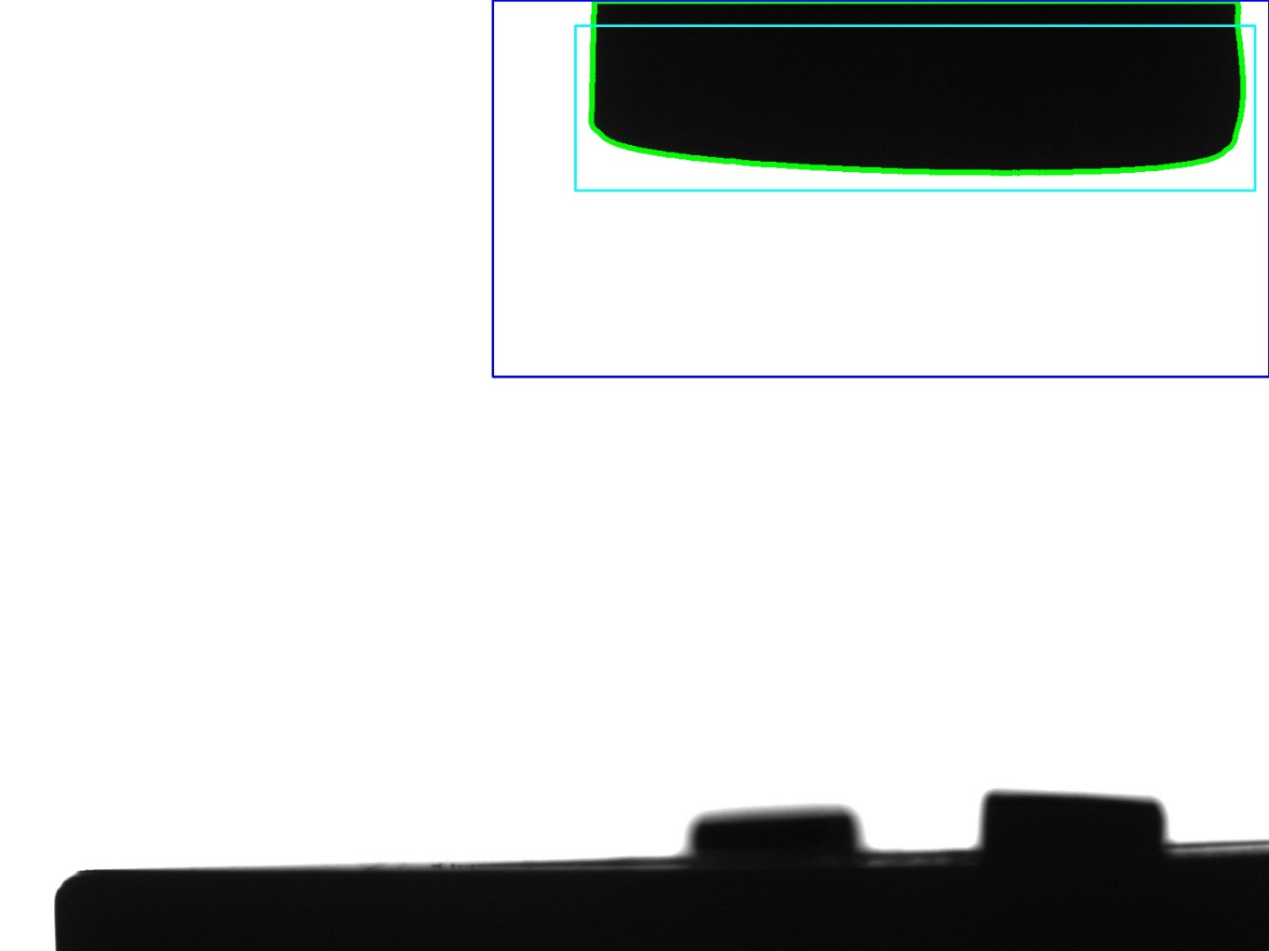
Robot Gripper- Results
Image 2
Image 3
Console Output:
Template: 0.0 Disim
Image-1: 1.36311088973 Disim
Image-2: 0.0286209618648 Disim
Image-3: 0.0045508842333 Disim
Image-4: 0.190357587177 Disim
Image 4
‘Perfect’
Image 1
Images Courtesy of: Jean Jakoncic, AMX Beamline

Slide 18
Robot Gripper Time – 1-19 Images
Number of Images | Total Time | Average Time
1 | 0.526 | 0.526
2 | 0.716 | 0.358
3 | 0.886 | 0.29533333
4 | 1.066 | 0.2665
5 | 1.256 | 0.2512
6 | 1.429 | 0.23816667
7 | 1.6 | 0.22857143
8 | 1.783 | 0.222875
9 | 1.962 | 0.218
10 | 2.131 | 0.2131
11 | 2.324 | 0.21127273
12 | 2.493 | 0.20775
13 | 2.692 | 0.20707692
14 | 2.875 | 0.20535714
15 | 3.046 | 0.20306667
16 | 3.335 | 0.2084375
17 | 3.42 | 0.20117647
18 | 3.543 | 0.19683333
19 | 3.74 | 0.19684211

Slide 19
Pin/Gripper – ‘Perfect’ vs Test Cases
Image 1
Image 2
‘Perfect’
Image 3
Image 4
Images Courtesy of: Jean Jakoncic, AMX Beamline

Slide 20
Pin/Gripper Detailed Analysis
Purpose:
Find Pin and Gripper ROI’s
Compare Apparatus to ‘Perfect’ for anomalies
Discover Possible Kinks within image
Discover if Pin is not properly mounted
Discover the Center of Mass
Use Extreme Points as an assist for Alignment, along with Centroid

Slide 21
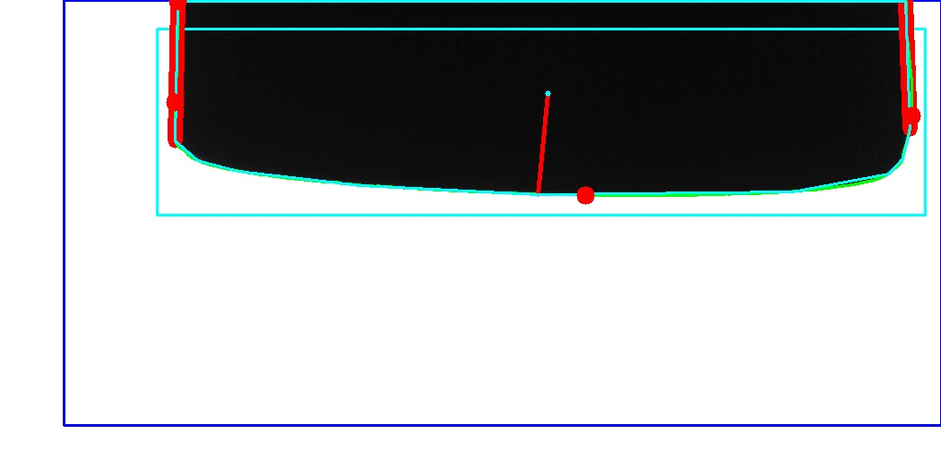
Pin/Gripper Image Analysis – Results – Image 1
Match Metrics:
Image Dissimilarity: 1.36080901012
Mount Centroid: Too High: 104
Missing Component / Gripper Not Aligned
Console Output on Image 1:
Image 1:
perimeter: 2017.74725473
max: (745, 1)
height: 217
extrema: {'B': (1203, 218), 'R': (1567, 129),
'L': (745, 114), 'T': (748, 1)}
area: 168731.5
min: (793, 1)
sum intensity: 4280971
width: 822
centroid: (1161, 104)
mean intensity: 23.999971969
Images Courtesy of: Jean Jakoncic, AMX Beamline

Slide 22
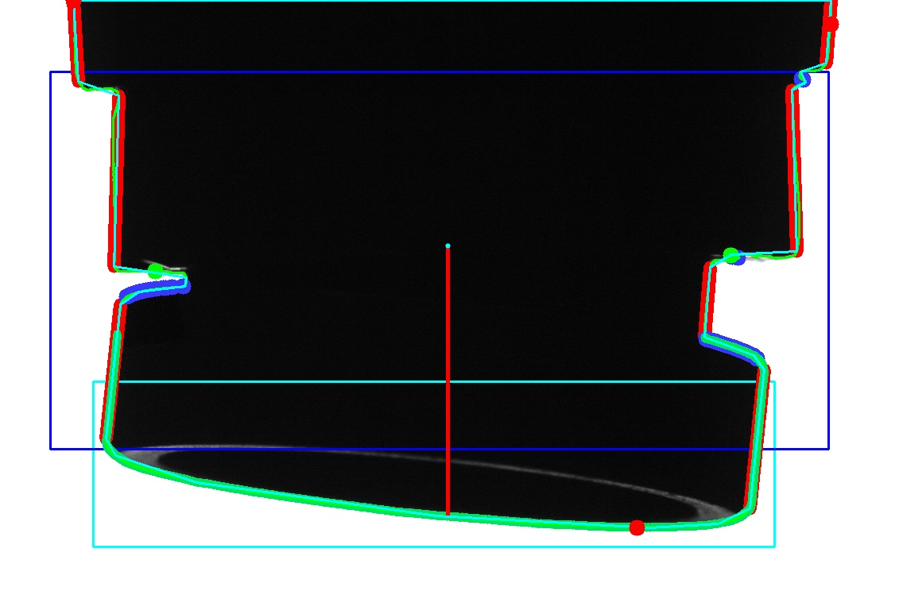
Pin/Gripper Image Analysis – Results – Image 2
Match Metrics:
Image Dissimilarity: 0.0274253192917
Possible Kinks Detected
41 Possible Kink Points Detected: Adjust Gripper
Possible Kink Distance on R: 115.004347744
Possible Kink Distance on L: 27.3130005675
Pin Not Mounted Correctly: Distance: 329
Console Output:
Image 2:
perimeter: 3512.21232665
max: (497, 66)
height: 664
extrema: {'B': (1206, 665), 'R': (1450, 31),
'L': (497, 1), 'T': (497, 1)}
aspect ratio: 1.43458646617
area: 532620.5
min: (515, 1)
sum intensity: 30095708
width: 953
centroid: (968, 310)
mean intensity: 47.5601903943
Images Courtesy of: Jean Jakoncic, AMX Beamline

Slide 23
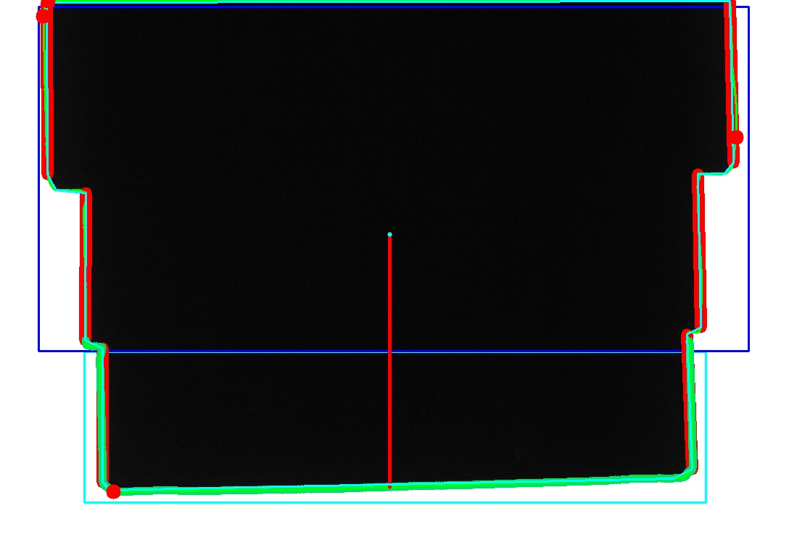
Pin/Gripper Image Analysis – Results – Image 3
Console Output:
Image 3:
perimeter: 3272.13917053
max: (496, 1)
height: 677
extent: 0.902237973263
extrema: {'B': (593, 678), 'R': (1452, 189),
'L': (496, 22), 'T': (503, 1)}
area: 585413.5
min: (525, 1)
sum intensity: 20199272
width: 956
centroid: (974, 323)
mean intensity: 31.2096685476
Match Metrics:
Image Dissimilarity: 0.00487836456791
Images Courtesy of: Jean Jakoncic, AMX Beamline

Slide 24
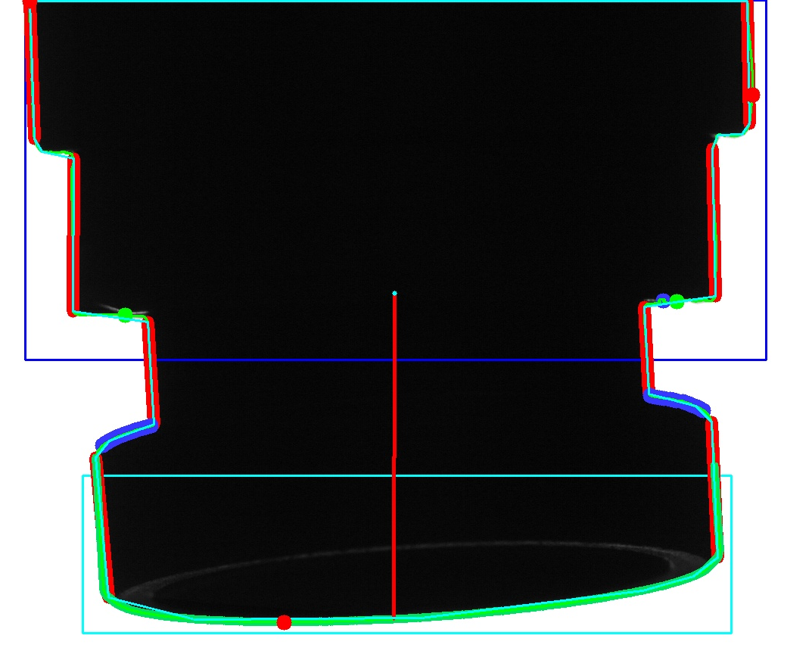
Pin/Gripper Image Analysis – Results – Image 4
Match Metrics:
Image Dissimilarity: 0.190836638543
Possible Kinks Detected
44 Possible Kink Points Detected: Adjust Gripper
Possible Kink Distance on R: 125.015998976
Possible Kink Distance on L: 157.003184681
Pin Not Mounted Correctly: Distance: 411
Console Output:
Image 4:
perimeter: 3790.45496655
max: (1443, 1)
height: 821
extrema: {'B': (828, 822), 'R': (1447, 125),
'L': (492, 1), 'T': (492, 1)}
aspect ratio: 1.16301703163
area: 664209.0
min: (503, 1)
sum intensity: 35452804
width: 955
centroid: (974, 387)
mean intensity: 45.2172411374
Images Courtesy of: Jean Jakoncic, AMX Beamline

Slide 25
Pin/Gripper Time – 1-19 Images
Number of Images | Total Time | Average Time
1 | 0.544 | 0.544
2 | 0.751 | 0.3755
3 | 0.945 | 0.315
4 | 1.162 | 0.2905
5 | 1.361 | 0.2722
6 | 1.565 | 0.26083333
7 | 1.802 | 0.25742857
8 | 1.999 | 0.249875
9 | 2.192 | 0.24355556
10 | 2.429 | 0.2429
11 | 2.621 | 0.23827273
12 | 2.803 | 0.23358333
13 | 3.064 | 0.23569231
14 | 3.264 | 0.23314286
15 | 3.482 | 0.23213333
16 | 3.637 | 0.2273125
17 | 3.824 | 0.22494118
18 | 4.1 | 0.22777778
19 | 4.302 | 0.22642105

Slide 26
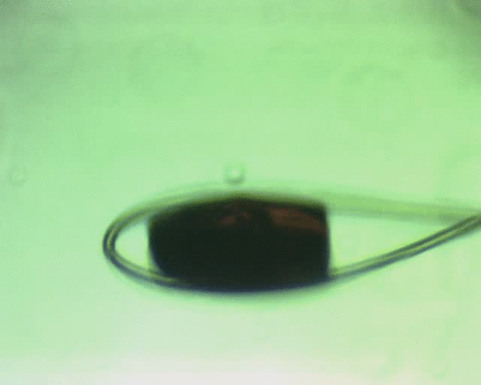
Crystal Rotational Alignment - AMX
Purpose:
Locate the Crystal
Center the Crystal in Goniostat
Plot as a function of angles the Y Pixel coordinate of Crystal during rotation
Images Courtesy of: Jean Jakoncic, AMX Beamline

Slide 27
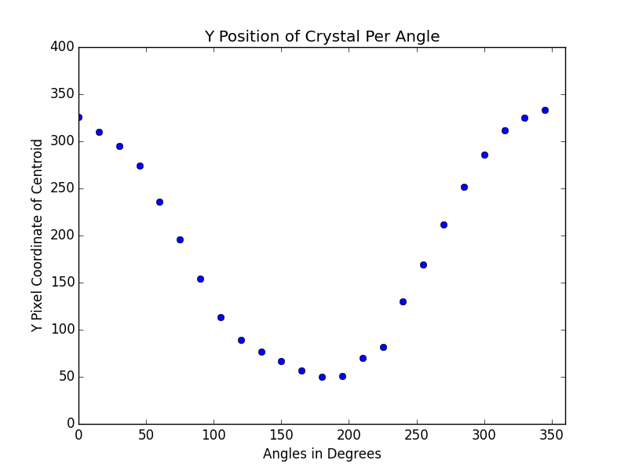
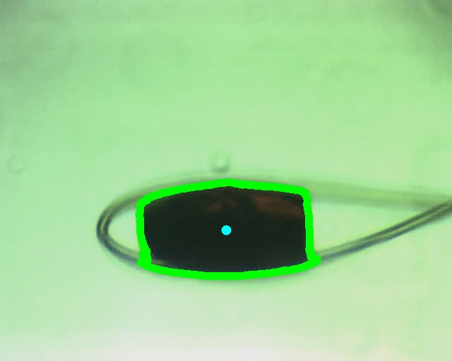
Crystal Rotational Alignment - AMX
Centering Crystal:
Total Time (24 Img): 0.858s Average Time: 0.035s
Images Courtesy of: Jean Jakoncic, AMX Beamline

Slide 28
Conclusion
Computer Vision provides:
Center Samples in Goniostat (ABBIX, IXS, etc.)
Automated Robotic Mounting and Sample Detection (AMX)
Assist in alignments of samples, crystals, and beams
Discovers and reports information about objects within an image
Prevent potential problems by alerting users of anomalies
With OpenCV 3.1.0 and the Intel IPP Library, all CV functions run at optimized speeds, providing the best computational results currently available.

Slide 29
Future Plans - XPD
XPD X-Ray Diffraction Scoring Analysis:
Discover Diffraction Circles
Integrate Intensities
Count Number of Circles
Count Total Diffraction in each Frame
Images Courtesy of: Sanjit Ghose, XPD Beamline

